Slide 1

Copyright of BW CUBESMART LLC

Slide 2
Overview
Introduction
Constraints
Authentication
Caching
HATEOAS
Options
PUT & POST
PATCH
Safe & Idempotent
Status Code
Copyright of BW CUBESMART LLC

Slide 3
Introduction
REpresentational State Transfer
Resource based
    nouns & verbs
    identified by uri
Representations
    how resources get manipulated
    Resource state transferred between client & server
Example
    Resource : Person (John)
    Service : Contact information (GET)
    Representation : name, address in json or xml format
Lightweight alternative to RPC and SOAP
Copyright of BW CUBESMART LLC

Slide 4
Constraints
6 constraints
  Uniform interface
    Interface between client & server
    Fundamental to REST design
    For this need to use
        HTTP verbs : GET, POST, PUT, DELETE
        URIs : resource name
        HTTP response : status, body
  Stateless
    Server contains no client state
    Each request is self descriptive message
    Any session state is held in client
    Server is stateless
    Client need to provide all information necessary to make
    the request
Copyright of BW CUBESMART LLC

Slide 5
  Client – Server - uniform interface is link between two
  Cacheable - server responses are cacheable
  Layered System
    Client can’t assume direct connection to server
    S/w or h/w intermediaries between client & server
  Code on demand
    Server temporarily extend client
    Transfer logic to client
    Client executes logic
    Eg.: Client - download js, java applet to encrypt
    Servers - not aware of encryption routines / keys used
    It is optional because, it reduces visibility
    Violating any other constraint other than cod means , service is not strictly restful
Constraints
(contd.)
Copyright of BW CUBESMART LLC

Slide 6

Authentication
HTTP basic authentication
  Add 'username:password' encoded in base64
  Credentials are encoded, they are not encrypted
  Easy to retrieve username & password
  This is only apply through SSL/TLS, not on plain HTTP
  Need to send password on every request (not safeguard against tampering)
Copyright of BW CUBESMART LLC

Slide 7

Authentication
(contd.)
  HMAC (Hash based Message Authentication)
    Send a hashed version of the password, with more information
    Eg.: To access a protected resource users/johndoe/financialrecords
      Concatenate the HTTP verb and the actual URL
      Add more information like current timestamp, random number, md5
      in order to prevent tampering or replay attacks
      Send this digest over as a HTTP header
      Server can generate the digest, since it has all information
      Eavesdropper can’t POST but he can access it, since it doesn't change the digest
Copyright of BW CUBESMART LLC

Slide 8

Authentication
(contd.)
    Add some more information like current time, and a nonce
    Server can reconstruct the digest, since the client sends over the nonce
    & date
    If date is not in a certain range of the current servers time (say, 10
    minutes), the server can ignore the message, as it probably is a replay
    To access the same resource again in same second, must change nonce
    number
    nonce is used to avoid replay attack
    There are no more passwords, but just plain secrets. When johns secret gets out ?????
Copyright of BW CUBESMART LLC

Slide 9
Authentication
(contd.)
OAuth (Open Standard for Authorization)
  Use temporary tokens
  With token and secret, it is allowed to access its protected
  resources
  Common used scheme for authentication and authorization
OAuth2
  New way of authentication which is easier to implement and
maintain
Copyright of BW CUBESMART LLC

Slide 10
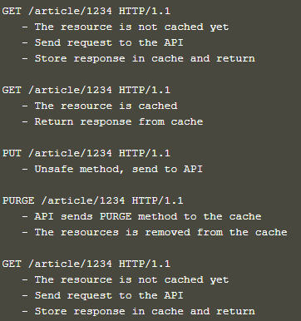
Caching
Safe method
  Reverse proxy should cache
  response that is returned from API
  Use this cached response to
  answer all requests for the same
  resource before they hit API
Unsafe method
  Cache ignores it and passes it to
  the API.
  The API is responsible for making
  sure that the cached resource
  is invalidated.
  Fire a PURGE request on that
  resource so that the reverse
  proxy knows that the cached
  resource should be expired
Copyright of BW CUBESMART LLC

Slide 11
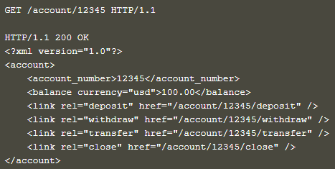
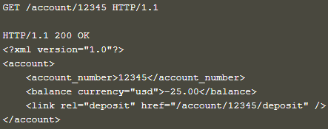
HATEOAS
Hypertext As The Engine Of Application State
  Hypertext used to find way through the API
  Hypertext is actually telling us what is allowed and what not
Copyright of BW CUBESMART LLC

Slide 12

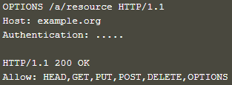
OPTIONS
To figure out which methods are supported on a resource
Return an ALLOW header, that returns all the methods the current
resource is capable of handling
Returns more methods, authentication header is added to the
request
Copyright of BW CUBESMART LLC

Slide 13

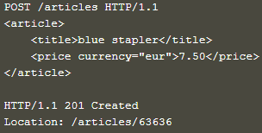
PUT & POST
PUT
  To create resources
  Update a resource completely
  through a specific resource
POST
  To update resources
  If do not know the actual resource location, when add a new
  article, but do not have any idea where to store it, you can POST
  it to an URL, and let the server decide the actual URL
Copyright of BW CUBESMART LLC

Slide 14

PATCH
PUT
  To update partial resources (first name)
  For single field updating, putting a complete resource
  representation utilizes more bandwidth
Copyright of BW CUBESMART LLC

Slide 15
Safe & Idempotent
Safe
  Do not modify resources
  GET or HEAD on a resource URL, should never change the
  resource (i.e.) it won't change the resource representation
  It change things on a server or resource, but this should not
  reflect in a different representation
    incorrect & delete the blogpost
  It cached, prefetched without any problem to the resource
Idempotent
  Called many times without different outcomes
  If the method called only once, or ten times over, result is same
  Applies to the result, not the resource
  a=4; and a++;
  Important in building a fault-tolerant API
Copyright of BW CUBESMART LLC

Slide 16
Safe & Idempotent (contd.)
HTTP Method | Safe | Idempotent
Options | Y | Y
GET | Y | Y
HEAD | Y | Y
PUT | N | Y
POST | N | N
DELETE | N | Y
PATCH | N | N
Copyright of BW CUBESMART LLC

Slide 17
Status Code
4xx
  To tell the client that a fault has taken place on THEIR side.
  They should not retransmit the same request again, so fix the error first
5 xx
  To tell the client something happened on the server and their
  request by itself was perfectly valid
  The client can continue and try again with the request without
  modification.
Copyright of BW CUBESMART LLC

Slide 18


Copyright of BW CUBESMART LLC

